Slide 1
CSE 440
Artificial Intelligence
Introduction to Artificial Intelligence
Dr. Mohammad Mahmudul Alam
Department of Electrical & Computer Engineering (ECE)
North South University (NSU)

Slide 2
Course Objective
Learn fundamentals of AI and its application in different field.
Formulate search problems and how to solve them.
Learn probabilistic models and problem solving.
Understand knowledge representation.
Learn and apply Machine Learning, Neural Networks, Reinforcement Learning techniques.

Slide 3
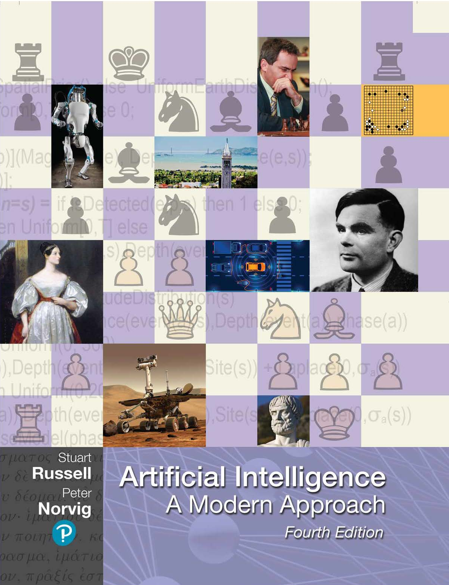
Book
“Artificial Intelligence: A modern approach” Stuart Russell, Peter Norvig, Prentice Hall, 4th Edition

Slide 4
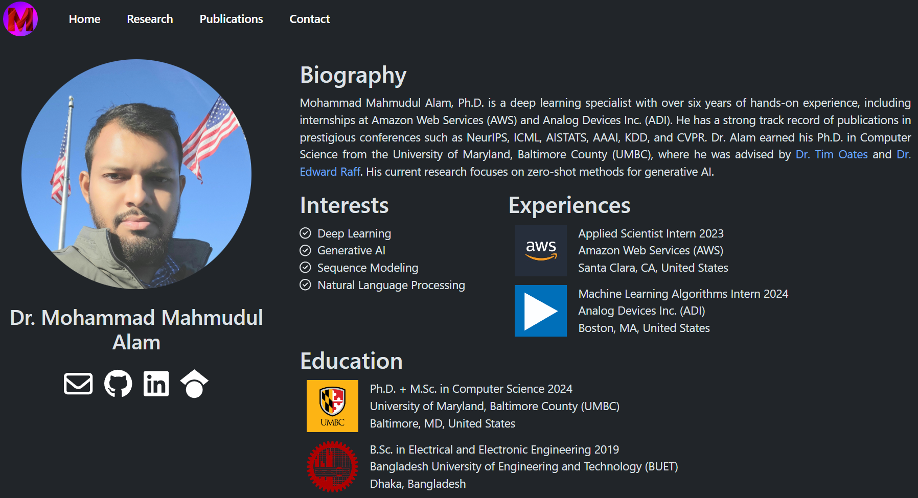
About Me
https://mahmudulalam.github.io/

Slide 5
What is Artificial Intelligence?
Some have defined intelligence in terms of fidelity to human performance
while others prefer an abstract, formal definition of intelligence called rationality—loosely speaking, doing the “right thing.”

Slide 6
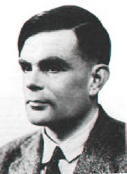
What is Artificial Intelligence?
In 1950 Alan Turing proposed an operational definition of intelligence by using a thought experiment composed of:
An interrogator (a person who will ask questions)
A computer (intelligent machine !!)
A person who will answer to questions
A curtain (separator)
This thought experiment gained lot of popularity and became known as Turing Test.

Slide 7
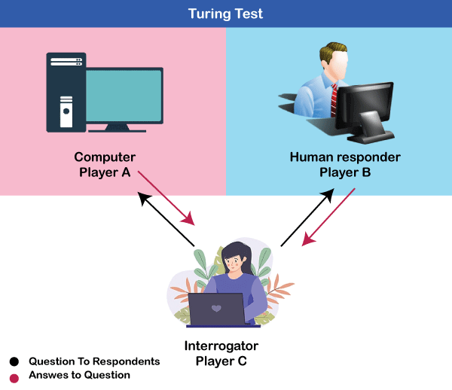
Turing Test
A computer passes the test if a human interrogator, after posing some written questions cannot tell whether the written responses come from a person or from a computer.

Slide 8
Turing Test
To pass the Turing test a computer would need to have the following capabilities:
Natural Language Processing to communicate successfully in a human language;
Knowledge Representation to store what it knows or hears;
Automated Reasoning to answer questions and to draw new conclusions;
Machine Learning to adapt to new circumstances and to detect and extrapolate patterns;
Computer Vision and speech recognition to perceive the world;
Robotics to manipulate objects and move about;

Slide 9
Types of AI
Weak AI: AI develops useful, powerful applications.
Strong AI: claims machines have cognitive minds comparable to humans.
In this course, we deal with Weak AI.

Slide 10
Goals of AI
AI began as an attempt to understand the nature of intelligence, but it has grown into a scientific and technological field affecting many aspects of commerce and society. The main goals of AI are:
Engineering: solve real-world problems using knowledge and reasoning. AI can help us solve difficult, real-world problems, creating new opportunities in business, engineering, and many other application areas.
Scientific: use computers as a platform for studying intelligence itself. Scientists design theories hypothesizing aspects of intelligence then they can implement these theories on a computer.
Even as AI Technology becomes integrated into the fabric of everyday life. AI researchers remain focused on the grand challenges of automating intelligence.

Slide 11
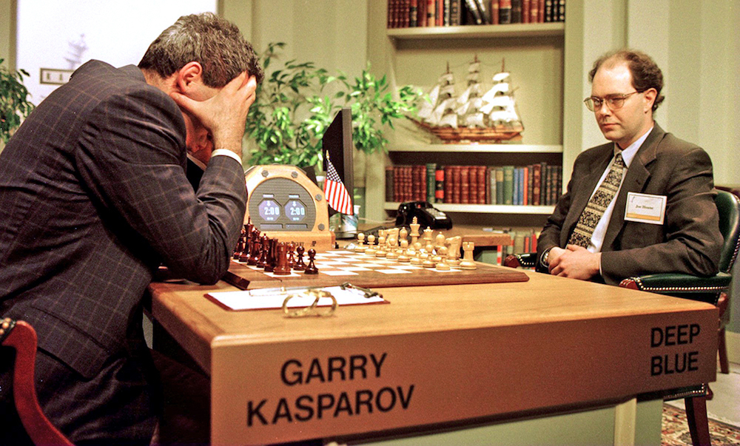

State-of-the-art of AI
Game Playing
In 1996, AI program called DeepBlue defeated the world chess champion, Garry Kasparov.
In 2016, an AI algorithm called AlphaGo defeated Lee Sedol, the world champion of the ancient Chinese board game.
Garry Kasparov
Lee Sedol

Slide 12

State-of-the-art of AI
Machine Translation
Machine translation systems now enable the reading of documents in over 100 languages
Including the native languages of over 99% of humans
Very close to human level translation

Slide 13

State-of-the-art of AI
Speech Recognition
In 2017, Microsoft showed that its Conversational Speech Recognition System had reached a word error rate of 5.1%.
Skype provides real-time speech-to-speech translation in ten languages.
Alexa, Siri, Cortana, and Google offer assistants that can answer questions and carry out tasks for the user.

Slide 14
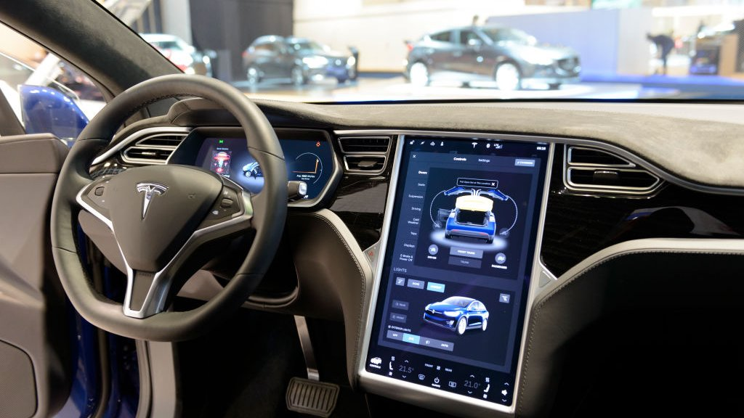
State-of-the-art of AI
Robotics
Self-driving cars
Mining, construction, agriculture
Garbage collection

Slide 15
State-of-the-art of AI
Diagnostic Systems
Pathfinder, a medical diagnosis system (suggests tests and makes diagnosis) developed by Heckerman and other Microsoft research
MYCIN system for diagnosing bacterial infections of the blood and suggesting treatments
Financial Decision Making
Credit card providers, banks, mortgage companies use AI systems to detect fraud and expedite financial transactions.

Slide 16
Topics Covered in This Course
Basics of an AI agents
Problem solving by searching
Ex. Uninformed search, Heuristic search
Knowledge-base representation
Ex. Propositional Logic, First Order Logic
Decision Networks
Ex. Bayes’ Net, Markov Models, Decision Trees, Machine Learning, Neural Networks

Slide 17
Why Search
Early works of AI was mainly towards
proving theorems
solving puzzles
playing games
All AI is search!
Not totally true (obviously) but more true than you might think.
Finding a good/best solution to a problem amongst many possible solutions.

Slide 18
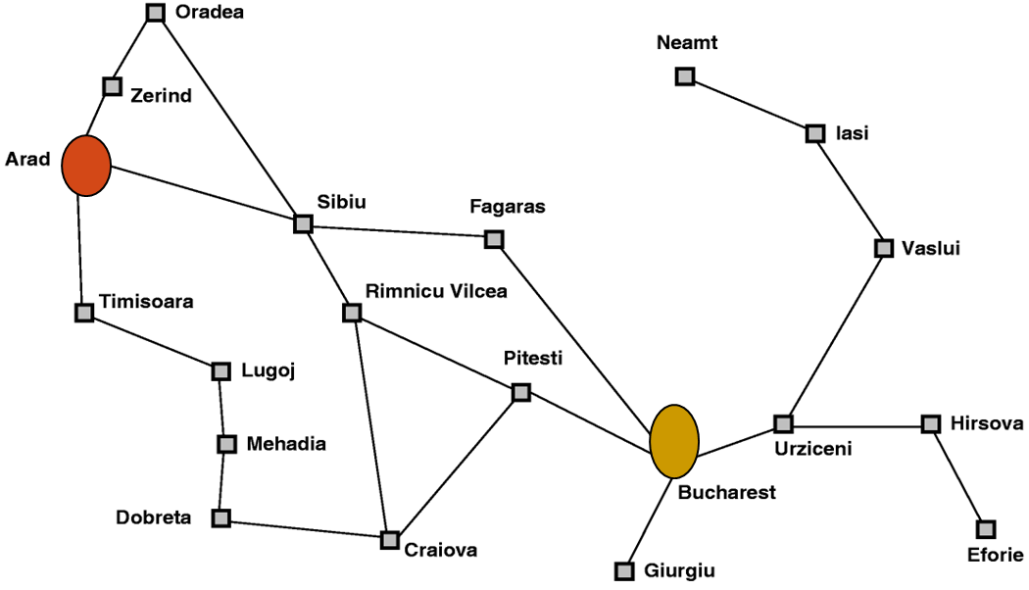

Classic AI Search Problems
Map searching (Navigation)
Google Map

Slide 19
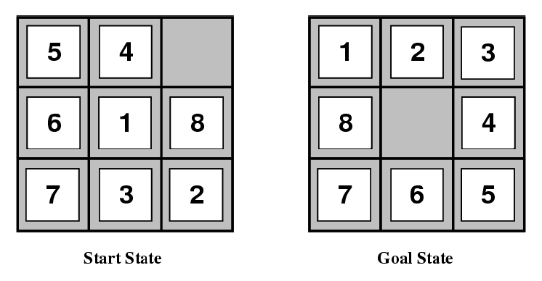
Classic AI Search Problems
8-puzzle
Given an initial configuration of 8 sliding numbered tiles on a 3 x 3
board, move the tiles in such a way so as to produce a desired goal
configuration of the tiles.

Slide 20
Classic AI Search Problems
Rubik’s Cube
43 252 003 274 489 856 000
43 quintillion

Slide 21
Knowledge-based System
Knowledge-based system (or expert system): a program which encapsulates knowledge from some domain, normally obtained from a human expert in that domain.
Components:
Knowledge Base (KB): A knowledge base (KB) is a set of representations of facts about the world
Working Memory: (if forward chaining used)
Inference Engine: the deduction system used to infer results from user input and KB
User Interface: interfaces with user
External Control + Monitoring: access external databases, control

Slide 22
Knowledge-based System
Why use knowledge-based/expert systems:
Commercial Viability: whereas there may be only a few experts whose time is expensive and rare, you can have many expert systems
Expert systems can be used anywhere, anytime
Expert systems can explain their line of reasoning
Weaknesses:
Expert systems are as good as their KB; errors in rules mean errors in diagnoses
Automatic error correction, learning is difficult (although machine learning research may change this)
The extraction of knowledge from an expert, and encoding it into machine-inferrable form is the most difficult part of expert system implementation

Slide 23
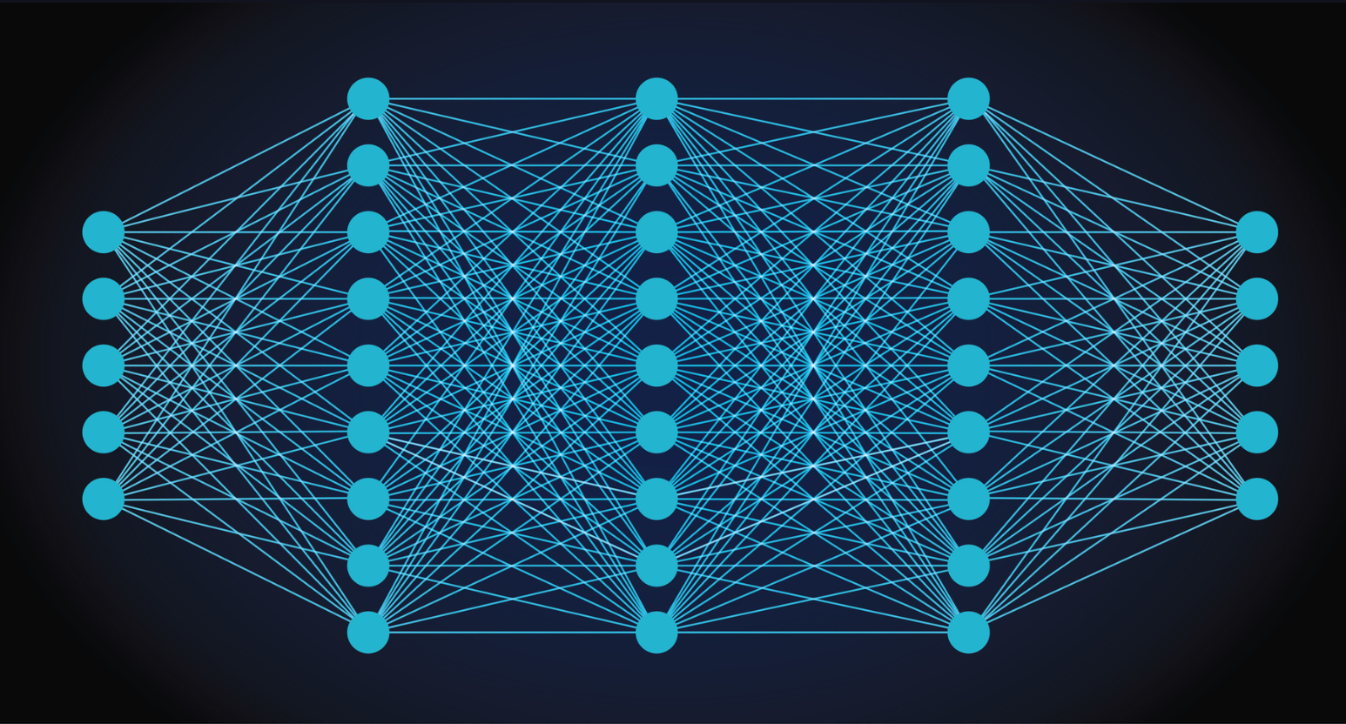

Machine Learning
Machine Learning : Neural Nets
Neural nets can be used to answer the following:
Pattern recognition: Does that image contain a face?
Classification problems: Is this cell defective?
Prediction: Given these symptoms, the patient has disease X
Forecasting: predicting behavior of stock market
Handwriting: is character recognized?
Optimization: Find the shortest path for the TSP.

